Slide 1

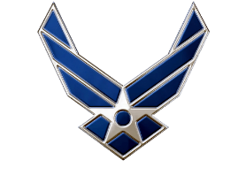
LRC’s Spring ‘24
Air Force ROTC Detachment 842
The University of Texas at San Antonio
C/1st Lt Dylan Fresquez
29 Feb 23

Slide 2


Overview
Timeline
Locations
Required Items
UOD
Safety/Execution
Air Force ROTC Detachment 842 • We Build Exceptional Officers • The University of Texas at San Antonio

Slide 3
Timeline
Cadets will arrive at Brackenridge lot NLT 0700
Cadets will depart to Lackland-Chapman Annex at 0720
Cadets will arrive at Lackland-Chapman Annex at 0800
LRCs will begin at 0820
Breaks will be be administered hourly
LRCs will end at 1200
Cadets will depart to UTSA at 1210
Air Force ROTC Detachment 842 • We Build Exceptional Officers • The University of Texas at San Antonio

Slide 4
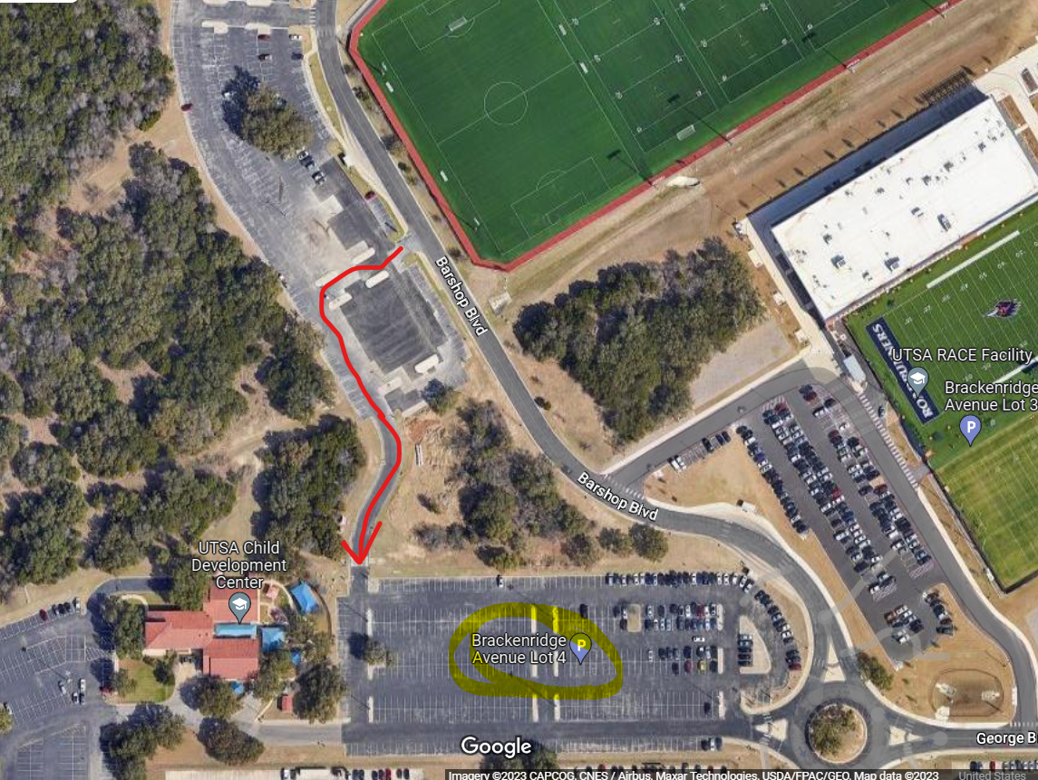
Locations
Cadets will arrive at Brackenridge lot 4. at 0700.
POC Flight Commanders will take accountability and check required items
GMC will separate into carpool groups and depart to Lackland-Chapman Annex at 0720
Air Force ROTC Detachment 842 • We Build Exceptional Officers • The University of Texas at San Antonio

Slide 5
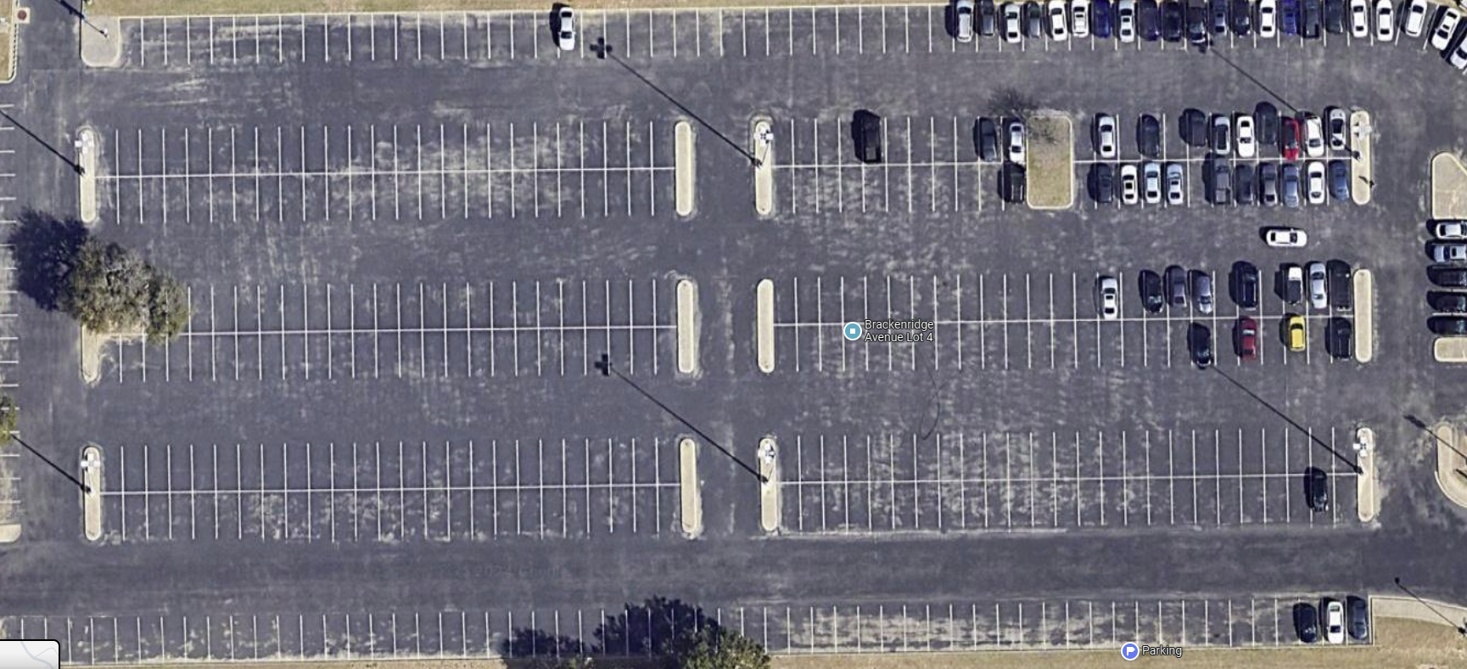
Locations
Delta
Echo
Foxtrot
Golf
Hotel
POC
Air Force ROTC Detachment 842 • We Build Exceptional Officers • The University of Texas at San Antonio

Slide 6
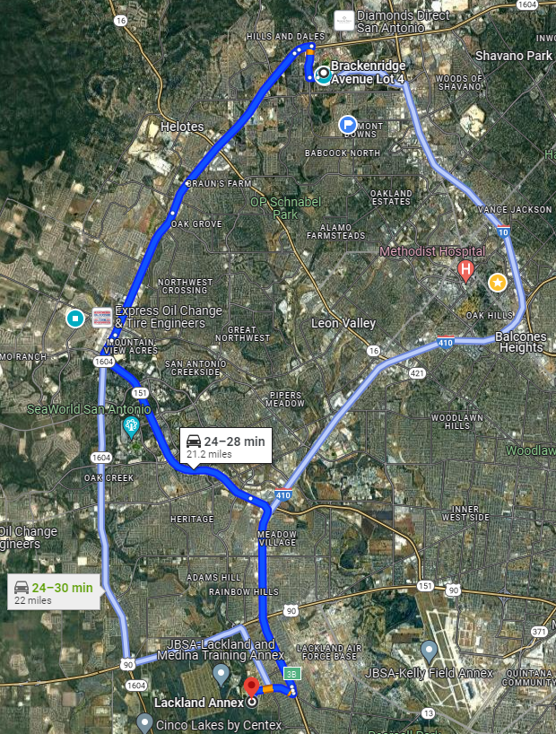
Locations
Location of LRC’s
29°22'10.0"N 98°39'13.7"W
Go through the Chapman Gate
Take a Left at the small road right before the Fire Station
POC will Guide
Air Force ROTC Detachment 842 • We Build Exceptional Officers • The University of Texas at San Antonio

Slide 7
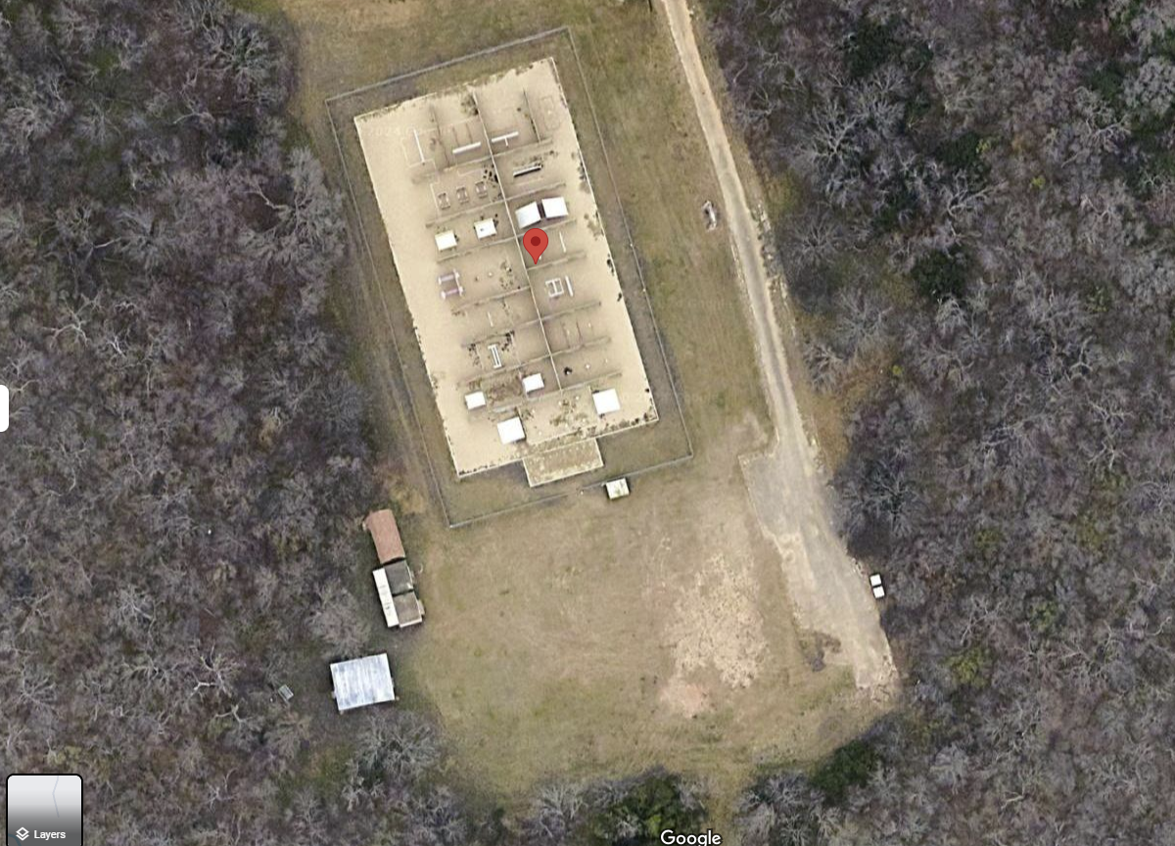
Locations
Cadet will park in the Red Outlined Area from Back to Front.
Cadets will form up to the side of the obstacle course, facing away from the obstacle course
Cadets will be split into groups and guided inside obstacle courses
LRC Courses
Air Force ROTC Detachment 842 • We Build Exceptional Officers • The University of Texas at San Antonio

Slide 8
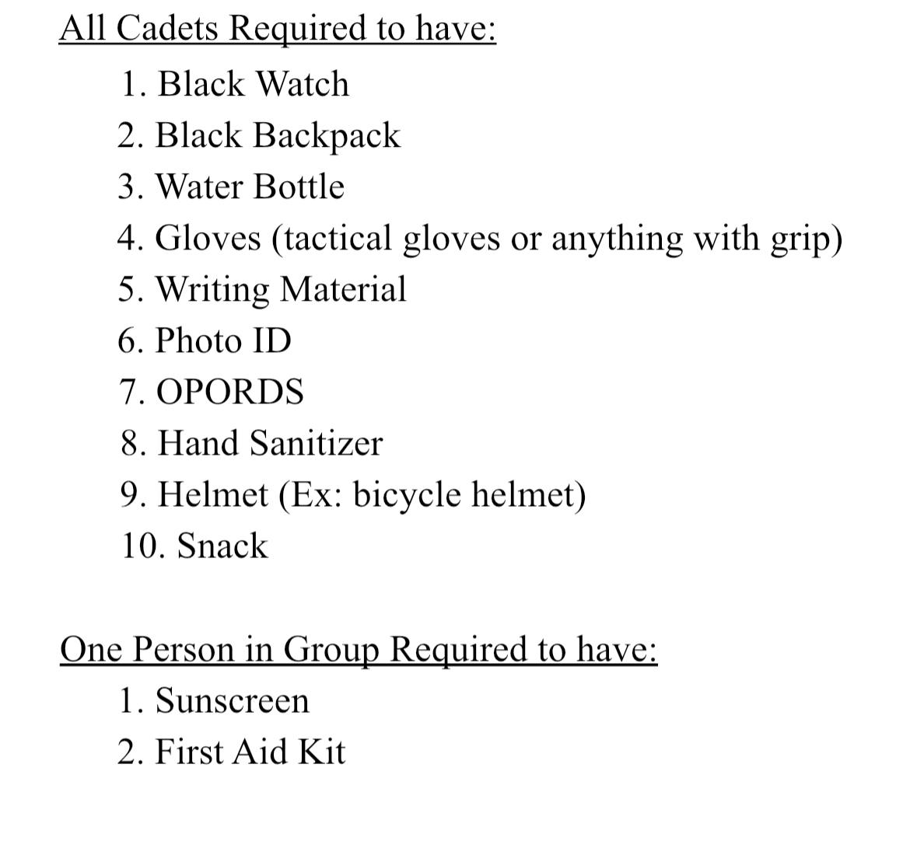
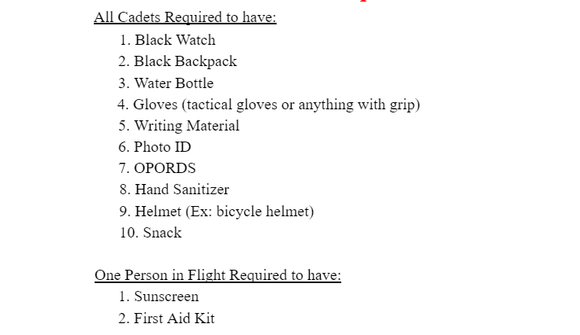
Required Items
Required items will be checked prior to transitioning to Camp Bullis
Air Force ROTC Detachment 842 • We Build Exceptional Officers • The University of Texas at San Antonio

Slide 9
UOD
Flights must be standardized
IMT/FTP
Det Shirt
Blue Jeans
Black Belt
Tennis Shoes
Black Watch
Black Jacket
Air Force ROTC Detachment 842 • We Build Exceptional Officers • The University of Texas at San Antonio

Slide 10
Safety/Execution
Obstacle courses are not playgrounds
Hydration
Helmets will be worn at all times
No Jewelry is permitted
Gloves will be worn at all times
Challenge yourself
Prepare to lead an LRC
Air Force ROTC Detachment 842 • We Build Exceptional Officers • The University of Texas at San Antonio

Slide 11
Summary
Timeline
Location
Required items
UOD
Safety/Execution
Air Force ROTC Detachment 842 • We Build Exceptional Officers • The University of Texas at San Antonio

Slide 12
Questions?

Slide 13
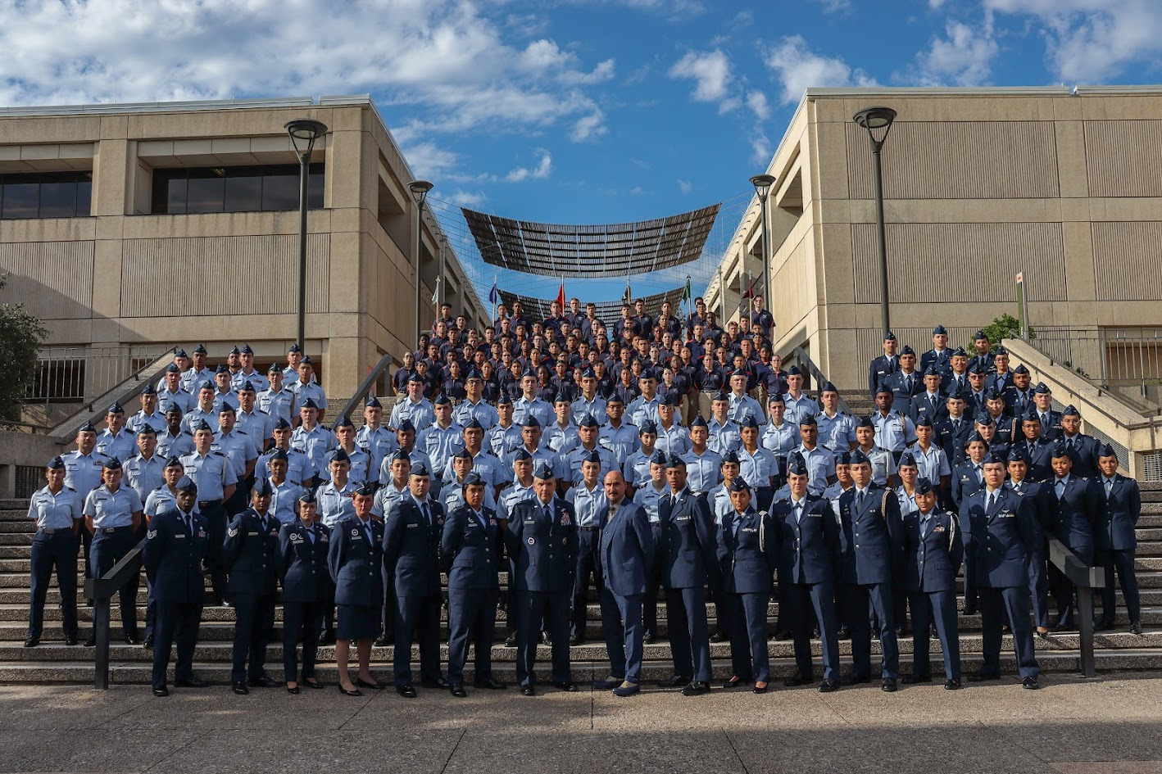
Air Force ROTC Detachment 842
The University of Texas at San Antonio
Det 842 – Best in Blue

